Slide 1
Health and Social Care in the Media
It is important to make the public realise about the issues which are prevailing in society relating to health and social care. One way in which public awareness is raised about health and social care in general and issues that exist within the health and social care sector is through the media.
Your task is to pick…
➢ x2 Films
➢ x1 Book
➢ x2 Documentaries
You will then be asked to write an essay with the following title: ‘Discuss the portrayal of Health and Social Care within the media’
You must watch/read the some of the examples on the previous slides you have picked and create notes to help with your essay. Consider the following:
• What issues, if any, are being raised in the stimulus?
• How does the stimulus present H&SC?
Is the stimulus informative/helpful and why?
• Are there any quotes/scenes etc that stand out to you and why?
• How effective is the stimulus in raising public awareness about H&SC/Issues?
This list is NOT exhaustive there may be other questions/ideas you wish to consider as you watch or read.
Documentary Suggestions:

Slide 2
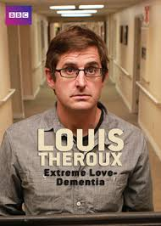
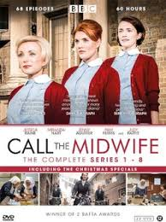
Babies
Marriage Story
Louis Theroux: Extreme love, Dementia
Five Feet Apart
Brain on Fire
Theory of Everything
What to expect when you’re expecting
Unbroken
Girl, interrupted
Call the Midwife
13 Reasons Why
Pandemic: How to prevent an outbreak
Recommended Watching for Health and Social Care

Slide 3
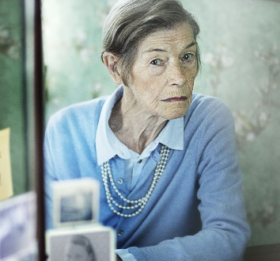
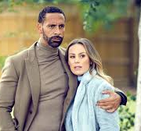
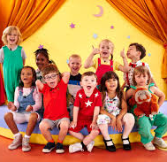
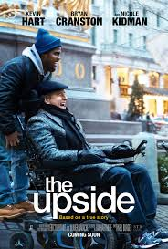
Beyond
Elizabeth is Missing
Rio & Kate: Becoming a Step family
Jesy Nelson: Odd one out
Bohemian Rhapsody
BBC iPlayer
DVD
Confessions of a Junior Doctor
Born to be different
Secret life of… Year Olds
Still Alice
4 On Demand
DVD
The Children Act
The Upside
Beautiful Boy
Miss you Already
Amazon Prime

Slide 4
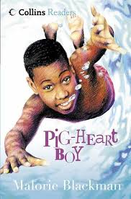
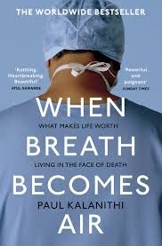
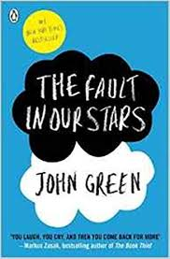
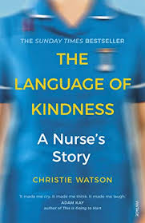
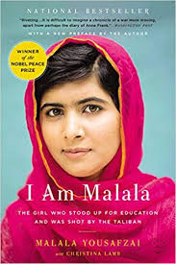
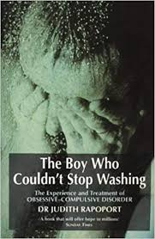
Beyond
Pig Heart Boy by Malorie Blackman
Wonder by R.J. Palacio
This is Going to Hurt by Adam Kay
When Breathe becomes Air by Paul Kalanithi
Further Reading
The Hate U Give by Angie Thomas
Me Before you by Jojo Moyes
The Fault in Our Stars by John Green
The Story of Baby P by Ray James
Savage Girls and Wild Boys by Michael Newton
The Language of Kindness by Christie Watson
I am Malala by Malala Yousafzai
The Boy Who Couldn’t Stop Washing by Dr Judith Rapaport
Recommended Reading for Health and Social Care
Yes some of these are also films, if you prefer!

