Slide 1
The PiXL Club The PiXL Club The PiXL Club The PiXL Club The PiXL Club The PiXL Club The PiXL Club The PiXL Club The PiXL Club The PiXL Club The PiXL Club The PiXL Club The PiXL Club The PiXL Club The PiXL Club The PiXL Club The PiXL Club The PiXL Club The PiXL Club The PiXL Club The PiXL Club The PiXL Club The PiXL Club The PiXL Club The PiXL Club The PiXL Club The PiXL Club The PiXL Club The PiXL Club The PiXL Club The PiXL Club The PiXL Club The PiXL Club The PiXL Club The PiXL Club The PiXL Club The PiXL Club The PiXL Club The PiXL Club The PiXL Club The PiXL Club The PiXL Club The PiXL Club The PiXL Club The PiXL Club XL Club The PiXL Club The PiXL Club The PiXL Club The PiXL Club The PiXL Club The PiXL Club The PiXL Club The PiXL Club The PiXL Club The PiXL Club The PiXL Club The PiXL Club The PiXL Club The PiXL Club The PiXL Club The PiXL Club The PiXL Club The PiXL Club The PiXL Club The PiXL Club The PiXL Club The PiXL Club The PiXL Club The PiXL Club The PiXL Club The PiXL Club The PiXL Club The PiXL Club The PiXL Club The PiXL Club The PiXL Club The PiXL Club The PiXL Club The PiXL Club The PiXL Club The PiXL Club The PiXL Club The PiXL Club The PiXL Club The PiXL Club The PiXL Club The PiXL Club The PiXL Club The PiXL Club The PiXL Club The PiXL Club The PiXL Club The PiXL Club The PiXL Club The PiXL Club The PiXL Club The PiXL Club The PiXL Club The PiXL Club The PiXL Club The PiXL Club The PiXL Club The PiXL Club The PiXL Club The PiXL Club The PiXL Club The PiXL Club The PiXL Club The PiXL Club The PiXL Club The PiXL Club The PiXL Club The PiXL Club The PiXL Club The PiXL Club The PiXL Club The PiXL Club The PiXL Club The PiXL Club The PiXL Club The PiXL Club The PiXL Club The PiXL Club The PiXL Club The PiXL Club The PiXL Club The PiXL Club The PiXL Club The PiXL Club The PiXL Club The PiXL Club The PiXL Club The PiXL Club The PiXL Club The PiXL Club The PiXL Club The PiXL Club The PiXL Club The PiXL Club The PiXL Club The PiXL Club The PiXL Club The PiXL Club The PiXL Club The PiXL Club The PiXL Club The PiXL Club The PiXL Club The PiXL Club The PiXL Club The PiXL Club The PiXL Club The PiXL Club The PiXL Club The PiXL Club The PiXL Club The PiXL Club The PiXL Club The PiXL Club The PiXL Club The PiXL Club The PiXL Club The PiXL Club The PiXL Club The PiXL Club The PiXL Club The PiXL Club The PiXL Club The PiXL Club The PiXL Club The PiXL Club The PiXL Club The PiXL Club The PiXL Club The PiXL Club The PiXL Club The PiXL Club The PiXL Club The PiXL Club The PiXL Club The PiXL Club The PiXL Club The PiXL Club The PiXL Club The PiXL Club The PiXL Club The PiXL Club The PiXL Club The PiXL Club The PiXL Club The PiXL Club The PiXL Club The PiXL Club The PiXL Club The PiXL Club The PiXL Club The PiXL Club The PiXL Club The PiXL Club The PiXL Club The PiXL Club The PiXL Club The PiXL Club The PiXL Club The PiXL Club The PiXL Club The PiXL Club The PiXL Club The PiXL Club The PiXL Club The PiXL Club The PiXL Club The PiXL Club The PiXL Club The PiXL Club The PiXL Club The PiXL Club The PiXL Club The PiXL Club The PiXL Club The PiXL Club The PiXL Club The PiXL Club The PiXL Club The PiXL Club The PiXL Club The PiXL Club The PiXL Club The PiXL Club The PiXL Club The PiXL Club The PiXL Club The PiXL Club The PiXL Club The PiXL Club The PiXL Club The PiXL Club The PiXL Club The PiXL Club The PiXL Club The PiXL Club The PiXL Club The PiXL Club The PiXL Club The PiXL Club The PiXL Club The PiXL Club The PiXL Club The PiXL Club The PiXL Club The PiXL Club The PiXL Club The PiXL Club The PiXL Club The PiXL Club The PiXL Club The PiXL Club The PiXL Club The PiXL Club The PiXL Club The PiXL Club The PiXL Club The PiXL Club The PiXL Club The PiXL Club The PiXL Club The PiXL Club The PiXL Club The PiXL Club The PiXL Club The PiXL Club The PiXL Club The PiXL Club The PiXL Club The PiXL Club The PiXL Club The PiXL Club The PiXL Club The PiXL Club The PiXL Club The PiXL Club The PiXL Club The PiXL Club The PiXL Club The PiXL Club The PiXL Club The PiXL Club The PiXL Club The PiXL Club The PiXL Club The PiXL Club The PiXL Club The PiXL Club The PiXL Club The PiXL Club The PiXL Club The PiXL Club The PiXL Club The PiXL Club The PiXL Club The PiXL Club The PiXL Club The PiXL Club The PiXL Club The PiXL Club The PiXL Club The PiXL Club The PiXL Club The PiXL Club The PiXL Club The PiXL Club The PiXL Club The PiXL Club The PiXL Club The PiXL Club The PiXL Club The PiXL Club The PiXL Club The PiXL Club The PiXL Club The PiXL Club The PiXL Club The PiXL Club The PiXL Club The PiXL Club The PiXL Club The PiXL Club The PiXL Club The PiXL Club The PiXL Club The PiXL Club The PiXL Club The PiXL Club The PiXL Club The PiXL Club The PiXL Club The PiXL Club The PiXL Club The PiXL Club The PiXL Club The PiXL Club The PiXL Club The PiXL Club The PiXL Club The PiXL Club The PiXL Club The PiXL Club The PiXL Club The PiXL Club The PiXL Club The PiXL Club The PiXL Club The PiXL Club The PiXL Club The PiXL Club The PiXL Club The PiXL Club The PiXL Club The PiXL Club The PiXL Club The PiXL Club The PiXL Club The PiXL Club The PiXL Club The PiXL Club The PiXL Club The PiXL Club The PiXL Club The PiXL Club The PiXL Club The PiXL Club The PiXL Club The PiXL Club The PiXL Club The PiXL Club The PiXL Club The PiXL Club The PiXL Club The PiXL Club The PiXL Club The PiXL Club The PiXL Club The PiXL Club The PiXL Club The PiXL Club The PiXL Club The PiXL Club The PiXL Club The PiXL Club The PiXL Club The PiXL Club The PiXL Club The PiXL Club The PiXL Club The PiXL Club The PiXL Club The PiXL Club The PiXL Club The PiXL Club The PiXL Club The PiXL Club The PiXL Club The PiXL Club The PiXL Club The PiXL Club The PiXL Club The PiXL Club The PiXL Club The PiXL Club The PiXL Club The PiXL Club The PiXL Club The PiXL Club The PiXL Club The PiXL Club The PiXL Club The PiXL Club The PiXL Club The PiXL Club The PiXL Club The PiXL Club The PiXL Club The PiXL Club The PiXL Club The PiXL Club The PiXL Club The PiXL Club The PiXL Club The PiXL Club The PiXL Club The PiXL Club The PiXL Club The PiXL Club The PiXL Club The PiXL Club The PiXL Club The PiXL Club The PiXL Club The PiXL Club The PiXL Club The PiXL Club The PiXL Club The PiXL Club The PiXL Club The PiXL Club The PiXL Club The PiXL Club The PiXL Club The PiXL Club The PiXL Club The PiXL Club The PiXL Club The PiXL Club The PiXL Club The PiXL Club The PiXL Club The PiXL Club The PiXL Club The PiXL Club The PiXL Club The PiXL Club The PiXL Club The PiXL Club The PiXL Club The PiXL Club The PiXL Club The PiXL Club The PiXL Club The PiXL Club The PiXL Club The PiXL Club The PiXL Club The PiXL Club The PiXL Club The PiXL Club The PiXL Club The PiXL Club The PiXL Club The PiXL Club The PiXL Club The PiXL Club The PiXL Club The PiXL Club The PiXL Club The PiXL Club The PiXL Club The PiXL Club The PiXL Club The PiXL Club The PiXL Club The PiXL Club The PiXL Club The PiXL Club The PiXL Club The PiXL Club The PiXL Club The PiXL Club The PiXL Club The PiXL Club The PiXL Club The PiXL Club The PiXL Club The PiXL Club The PiXL Club The PiXL Club The PiXL Club The PiXL Club The PiXL Club The PiXL Club The PiXL Club The PiXL Club The PiXL Club The PiXL Club The PiXL Club The PiXL Club The PiXL Club The PiXL Club The PiXL Club The PiXL Club The PiXL Club The PiXL Club The PiXL Club The PiXL Club The PiXL Club The PiXL Club The PiXL Club The PiXL Club The PiXL Club The PiXL Club The PiXL Club The PiXL Club The PiXL Club The PiXL Club The PiXL Club The PiXL Club The PiXL Club The PiXL Club The PiXL Club The PiXL Club The PiXL Club The PiXL Club The PiXL Club The PiXL Club The PiXL Club The PiXL Club The PiXL Club The PiXL Club The PiXL Club The PiXL Club The PiXL Club The PiXL Club The PiXL Club The PiXL Club The PiXL Club The PiXL Club The PiXL Club The PiXL Club The PiXL Club The PiXL Club The PiXL Club The PiXL Club The PiXL Club The PiXL Club The PiXL Club The PiXL Club The PiXL Club The PiXL Club The PiXL Club The PiXL Club The PiXL Club The PiXL Club The PiXL Club The PiXL Club The PiXL Club The PiXL Club The PiXL Club The PiXL Club The PiXL Club The PiXL Club The PiXL Club The PiXL Club The PiXL Club The PiXL Club The PiXL Club The PiXL Club The PiXL Club The PiXL Club The PiXL Club The PiXL Club The PiXL Club The PiXL Club The PiXL Club The PiXL Club The PiXL Club The PiXL Club The PiXL Club The PiXL Club The PiXL Club The PiXL Club The PiXL Club The PiXL Club The PiXL Club The PiXL Club The PiXL Club The PiXL Club The PiXL Club The PiXL Club The PiXL Club The PiXL Club The PiXL Club The PiXL Club The PiXL Club The PiXL Club The PiXL Club The PiXL Club The PiXL Club The PiXL Club The PiXL Club The PiXL Club The PiXL Club The PiXL Club The PiXL Club The PiXL Club The PiXL Club The PiXL Club The PiXL Club The PiXL Club The PiXL Club The PiXL Club The PiXL Club The PiXL Club The PiXL Club The PiXL Club The PiXL Club The PiXL Club The PiXL Club The PiXL Club The PiXL Club The PiXL Club The PiXL Club The PiXL Club The PiXL Club The PiXL Club The PiXL Club The PiXL Club The PiXL Club The PiXL Club The PiXL Club The PiXL Club The PiXL Club The PiXL Club The PiXL Club The PiXL Club The PiXL Club The PiXL Club The PiXL Club The PiXL Club The PiXL Club The PiXL Club The PiXL Club The PiXL Club The PiXL Club The PiXL Club The PiXL Club The PiXL Club The PiXL Club The PiXL Club The PiXL Club The PiXL Club The PiXL Club The PiXL Club The PiXL Club The PiXL Club The PiXL Club The PiXL Club The PiXL Club The PiXL Club The PiXL Club The PiXL Club The PiXL Club The PiXL Club The PiXL Club The PiXL Club The PiXL Club The PiXL Club The PiXL Club The PiXL Club The PiXL Club The PiXL Club The PiXL Club The PiXL Club The PiXL Club The PiXL Club The PiXL Club The PiXL Club The PiXL Club The PiXL Club The PiXL Club The PiXL Club The PiXL Club The PiXL Club The PiXL Club The PiXL Club The PiXL Club The PiXL Club The PiXL Club The PiXL Club The PiXL Club The PiXL Club The PiXL Club The PiXL Club The PiXL Club The PiXL Club The PiXL Club The PiXL Club The PiXL Club The PiXL Club The PiXL Club The PiXL Club The PiXL Club The PiXL Club The PiXL Club The PiXL Club The PiXL Club The PiXL Club The PiXL Club The PiXL Club The PiXL Club The PiXL Club The PiXL Club The PiXL Club The PiXL Club The PiXL Club The PiXL Club The PiXL Club The PiXL Club The PiXL Club The PiXL Club The PiXL Club The PiXL Club The PiXL Club The PiXL Club The PiXL Club The PiXL Club The PiXL Club
PiXL KnowIT!
GCSE Chemistry
AQA Topic – Organic Chemistry
(Alkenes, Alcohols, Carboxylic Acids, Esters, Polymers)
© Copyright The PiXL Club Ltd, 2017
This resource is strictly for the use of member schools for as long as they remain members of The PiXL Club. It may not be copied, sold nor transferred to a third party or used by the school after membership ceases. Until such time it may be freely used within the member school.
All opinions and contributions are those of the authors. The contents of this resource are not connected with nor endorsed by any other company, organisation or institution.
www.pixl.org.uk The PiXL Club Ltd, Company number 07321607

Slide 2
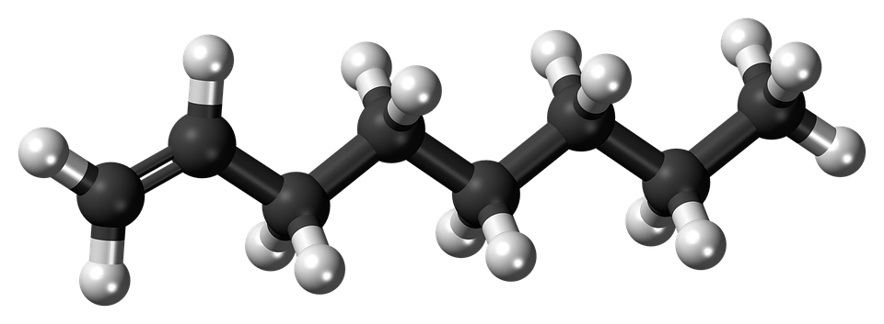
Structure and formulae of alkenes (Chemistry only)
We already know that alkanes have the general formulae C_{n}H_{2n+2}
Alkenes are hydrocarbons with a double carbon-carbon bond. The general formula for the homologous series of alkenes is C_{n}H_{2n}
The first four members of the alkanes are ethene, propene, butene and pentene.
There is no chemical called methene, as the double bond must be between two carbons. Any hydrocarbon starting with meth- can only have one carbon.

Slide 3
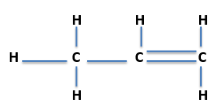
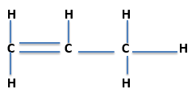
Structure and formulae of alkenes (Chemistry only)
Worked examples
Ethene has two carbon atoms so it’s formula will be C₂H_{(2x2)} this gives C₂H₄
Propene has three carbon atoms so it’s formula will be C₃H_{(2x3)} this gives C₃H₆
Butene has four carbon atoms so it’s formula will be C₄H_{(2x4)} this gives C₄H₈
Propene has five carbon atoms so it’s formula will be C₅H_{(2x5)} this gives C₅H₁₀
You will be expected to know the names and formulae of these first four alkenes, you will be expected to calculate the formulae of alkenes with more than five carbons
Where the double bond is placed is not important at this stage so for propene we can draw it in one of two ways e.g.
Both are C₃H₆
Or

Slide 4
Reaction of alkenes (Chemistry only)
Alkenes are hydrocarbons with the functional group C=C. This is the carbon-carbon double bond.
Alkenes react with oxygen in combustion reactions in the same way as other hydrocarbons, but they tend to burn in air with smoky flames because of incomplete combustion.
Alkenes can therefore react as alkanes do e.g.
butene + oxygen → carbon dioxide + water
C₄H₈ + 6O₂ → 4CO₂ + 4H₂O
Incomplete combustion however produces either carbon monoxide CO or carbon C i.e. C₄H₈ + 4O₂ → 4CO + 4H₂O
Or C₄H₈ + 2O₂ → 4C + 4H₂O
Alkenes react with hydrogen, water and the halogens (chlorine, bromine and iodine) by the addition of atoms across the carbon-carbon double bond so that the double bond becomes a single carbon-carbon bond.
Propene + hydrogen → propane
Propene + water → propanol
Propene + chlorine → dichloropropane

Slide 5
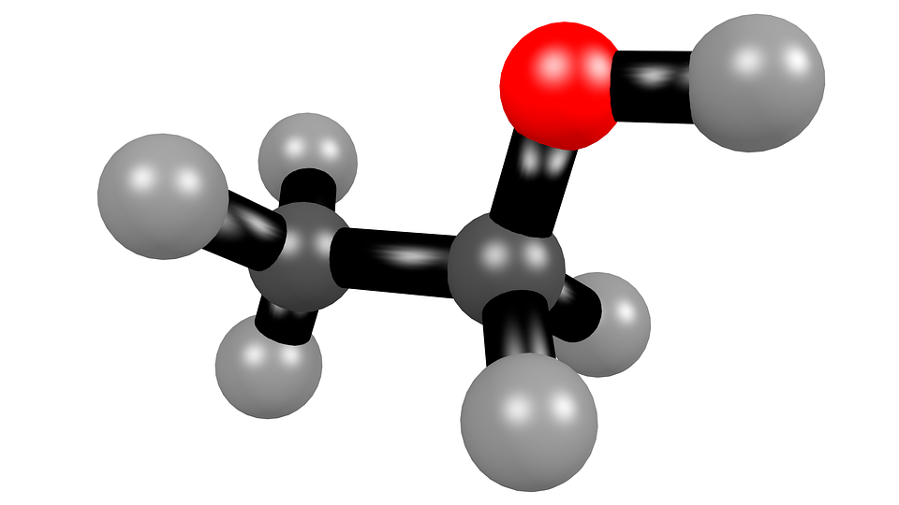
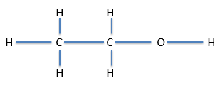
Reactions of alcohols (Chemistry only)
Alcohols contain the functional group -OH
Methanol has the formula CH₃OH
Ethanol has the formula CH₃CH₂OH or C₂H₅OH
Propanol has the formula CH₃CH₂CH₂OH or C₃H₇OH
Butanol has the formula CH₃CH₂CH₂CH₂OH or C₄H₉OH
An alternative way to show the alcohol structure is:

Slide 6
Reactions of alcohols (Chemistry only)
Alcohols have a number of important reactions:
When ethanol reacts with sodium, bubbles of hydrogen gas are given off and colourless sodium ethoxide solution is left
Sodium + ethanol → sodium ethoxide + hydrogen
All the alcohols dissolve in water to give colourless solutions with a pH of 7.
Alcohols can react with an oxidising reagent to make the carboxylic acid e.g. ethanol will oxidise to make ethanoic acid.
Alcohols also undergo combustion reactions with oxygen e.g.
Propanol + oxygen → carbon dioxide + water
C₃H₇OH + 5O₂ → 3CO₂ + 4H₂0
Aqueous solutions of ethanol are produced when sugar solutions are fermented using yeast.
The conditions needed for fermentation to happen are:
A temperature between 25^{O}C and 45^{O}C
Water but no oxygen

Slide 7
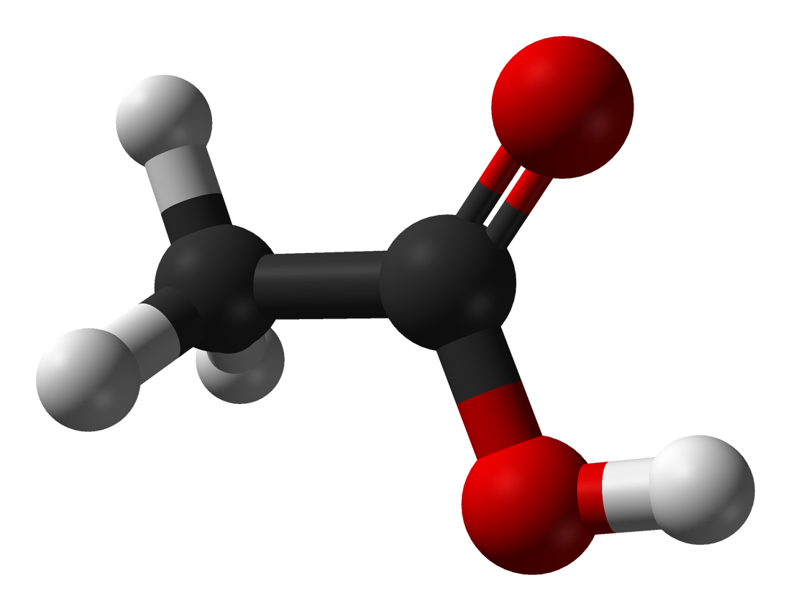
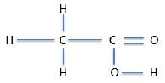
Reactions of carboxylic acids (Chemistry only)
Carboxylic acids have the functional group -COOH
Methanoic acid has the formula CHOOH
Ethanoic acid has the formula CH₃COOH
Propanoic acid has the formula C₂H₅COOH
Butanoic acid has the formula C₃H₇COOH
An alternative way to show the carboxylic acid structure is:

Slide 8
Reactions of carboxylic acids (Chemistry only)
Carboxylic acids have a number of important reactions:
When we react carboxylic acids with a metal carbonate a salt, carbon dioxide and water are produced e.g.
Sodium carbonate + propanoic acid → sodium propanoate + carbon dioxide + water
Carboxylic acids with five or less carbons dissolve in water. Carboxylic acids with more than five carbons in them are less soluble.
Carboxylic acids will react with alcohols to make an ester and water, an acid catalyst is needed (ethyl ethanoate is the ester below)
Ethanoic acid + ethanol → ethyl ethanoate + water
(HT only)
Carboxylic acids are described as weak acids as they are only partially ionised, therefore they give off relatively few hydrogen ions in comparison to strong acids and have a higher pH than strong acids.

Slide 9
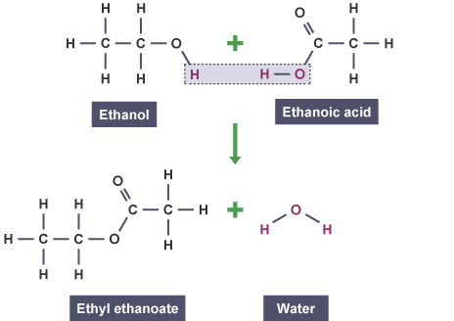
Esters: made when alcohols and carboxylic acids react together
You only need to learn this one example at GCSE!

Slide 10
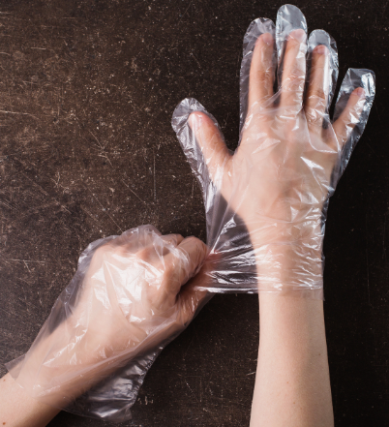
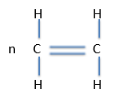
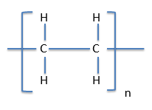
Addition polymerisation (Chemistry only)
Alkenes can be used to make polymers such as poly(ethane) and poly(propene) by addition polymerisation.
In addition polymerisation reactions, many small molecules (monomers) join together to form very large molecules (polymers).
Polythene has many uses.
An example of this is
One of the double bonds in the monomer breaks to form a single bond with other monomers. This leads to a very long polymer.
→
In addition polymers the repeating unit, n, has the same atoms as the monomer because no other molecule is formed in the reaction.
You must be able to move from the monomer to the polymer or polymer to the monomer

Slide 11
Condensation, polymerisation and amino acids (Chemistry HT only)
Condensation polymerisation involves monomers with two functional groups. When these types of monomers react they join together, usually losing small molecules such as water, and so the reactions are called condensation reactions.
The simplest polymers are produced from two different monomers with two of the same functional groups on each monomer.
An example of this is:
Ethane diol (this is ethane with two –di – alcohol – ol groups at either end)
HO – CH₂ – CH₂ – OH or HO - - OH
And
Hexanedioic acid (this is hexane with two carboxylic acid groups at the end)
HOOC - CH₂ - CH₂ - CH₂ - CH₂ – COOH or HOOC - - COOH
Polymerise to produce a polyester
n HO - -OH + n HOOC - - COOH → OOC COO + 2nH₂O
n

